Slide 1

WELCOME
analysis
conclusion
cad
about
limitations
comparison
TO THE ANSYS ANALYSIS
OF AERIAL CABLE CAR

Slide 2

analysis
conclusion
cad
about
comparison
limitations
ANSYS
2019 R3
ANSYS is a software package that lets you digitally model real world phenomena. It uses computer-based numerical techniques to solve physics problems.

Slide 3



Stress
Strain
Deformation
Fatique
1
2
3
4
cad
analysis
conclusion
about
limitations
comparison

Slide 4
FATIQUE TOOL
SAFETY FACTOR
DAMAGE
FATIQUE SENSTIVITY
LIFE

Slide 5
analysis
conclusion
cad
about
limitations
comparison
FIRST
CAD
MODEL
SECOND
CAD
MODEL
THEIR
COMPARISON

Slide 6
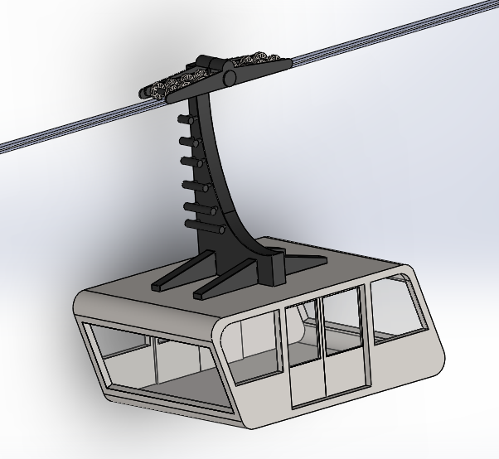
01
CAD MODEL
analysis
conclusion
cad
about
limitations
FIRST MODEL

Slide 7
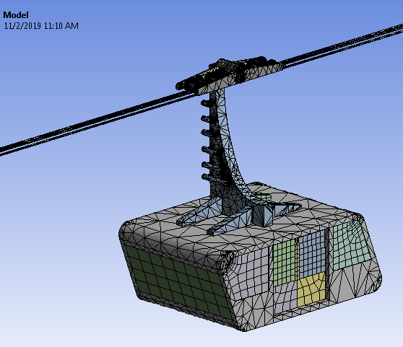
02
MESHED CAD MODEL
analysis
conclusion
cad
about
limitations
FIRST MODEL

Slide 8
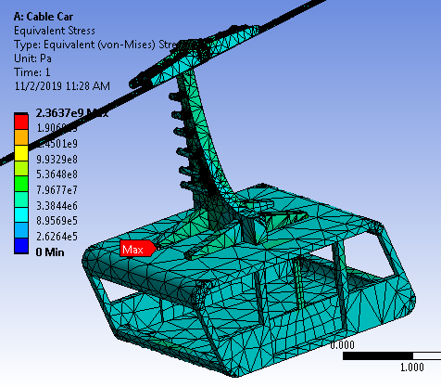
03
STRESS ANALYSIS
analysis
conclusion
cad
about
limitations
FIRST MODEL

Slide 9
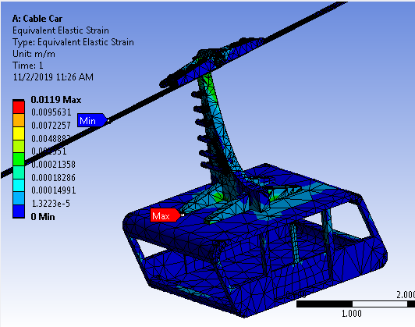
04
STRAIN ANALYSIS
analysis
conclusion
cad
about
limitations
FIRST MODEL

Slide 10
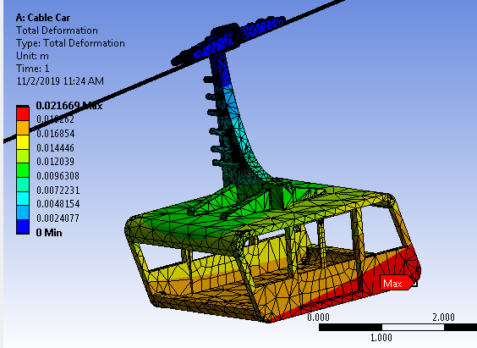
05
DEFORMATION
analysis
conclusion
cad
about
limitations
FIRST MODEL

Slide 11
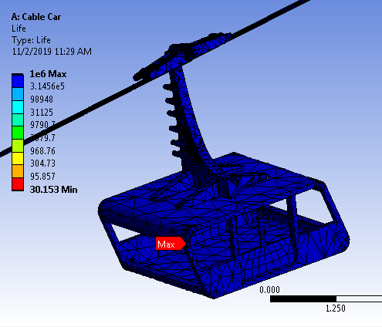
06
LIFE
analysis
conclusion
cad
about
limitations
FIRST MODEL

Slide 12
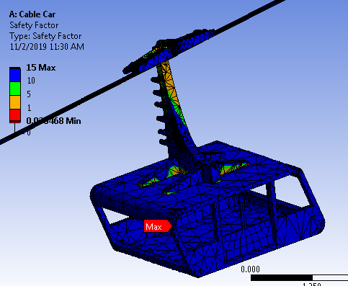
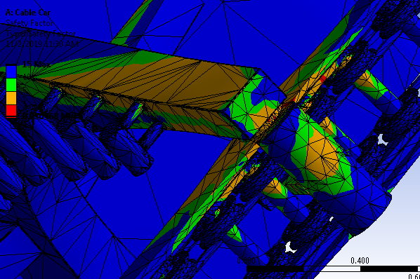
07
SAFETY FACTOR
analysis
conclusion
cad
about
limitations
FIRST MODEL

Slide 13
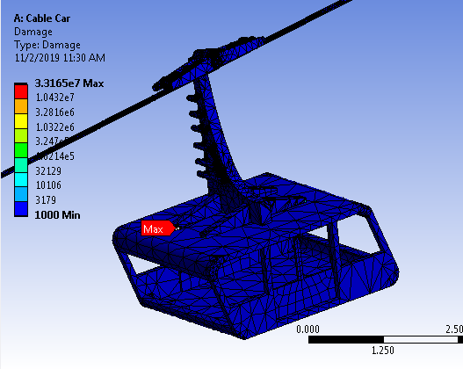
08
DAMAGE
analysis
conclusion
cad
about
limitations
FIRST MODEL

Slide 14
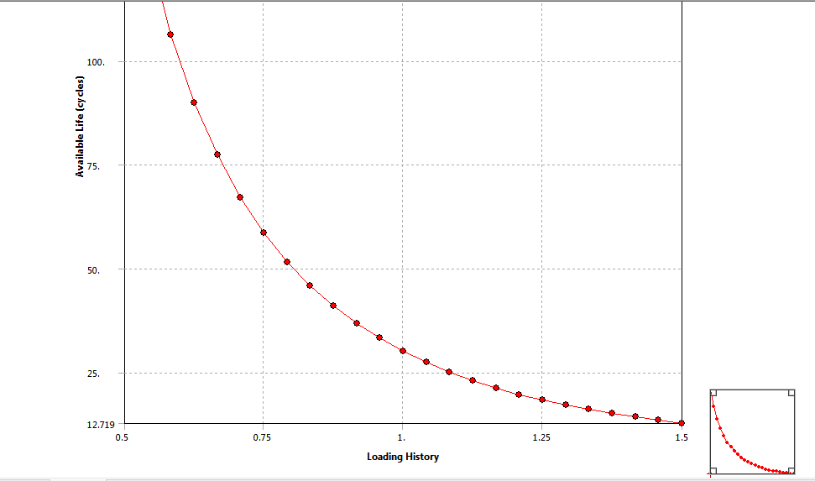
09
FATIQUE SENSTIVITY
analysis
conclusion
cad
about
limitations
FIRST MODEL

Slide 15
10
MOTION OF BODY
analysis
conclusion
cad
about
limitations
FIRST MODEL

Slide 16
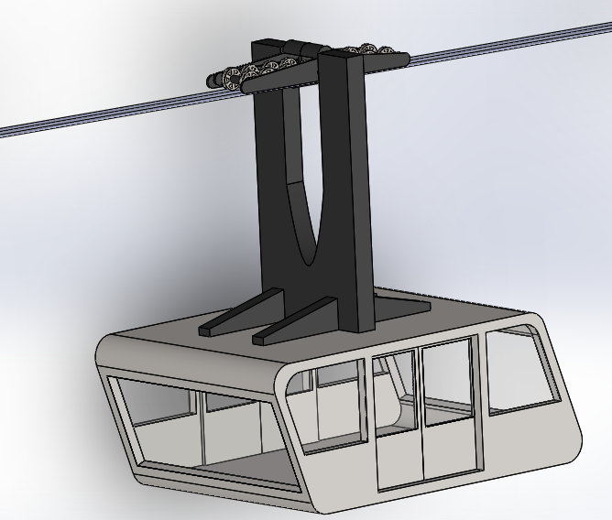
01
CAD MODEL
analysis
conclusion
cad
about
limitations
SECOND MODEL

Slide 17
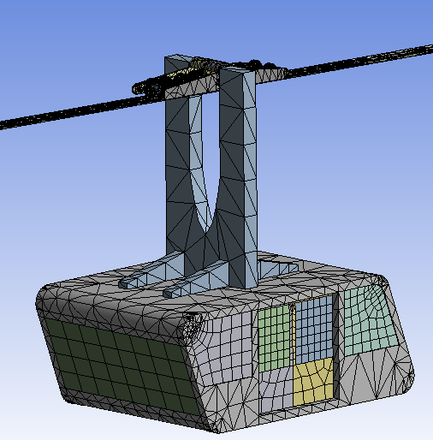
02
MESHED CAD MODEL
analysis
conclusion
cad
about
limitations
SECOND MODEL

Slide 18
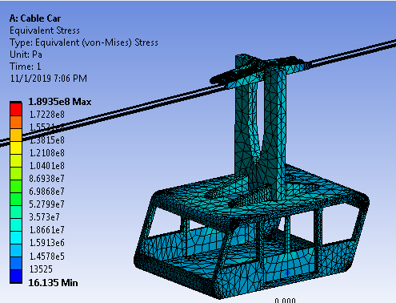
03
STRESS ANALYSIS
analysis
conclusion
cad
about
limitations
SECOND MODEL

Slide 19
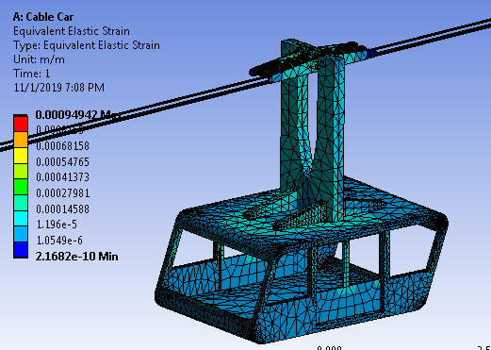
04
STRAIN ANALYSIS
analysis
conclusion
cad
about
limitations
SECOND MODEL

Slide 20
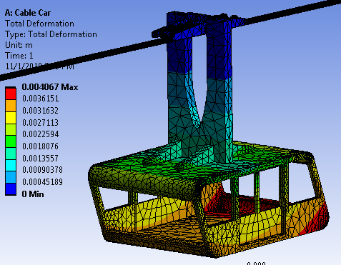
05
DEFORMATION
analysis
conclusion
cad
about
limitations
SECOND MODEL

Slide 21
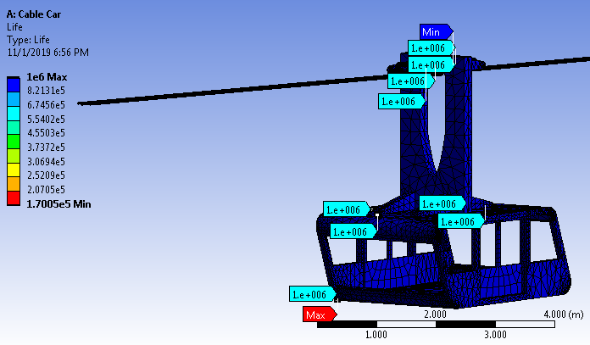
06
LIFE
analysis
conclusion
cad
about
limitations
SECOND MODEL

Slide 22
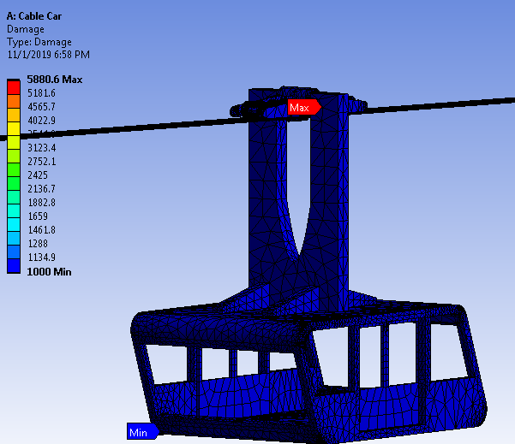
07
DAMAGE
analysis
conclusion
cad
about
limitations
SECOND MODEL

Slide 23
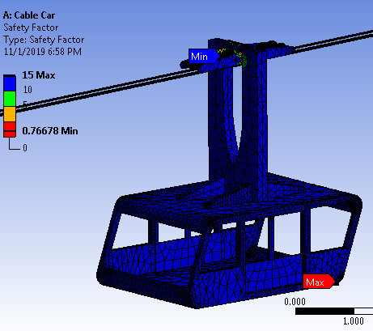
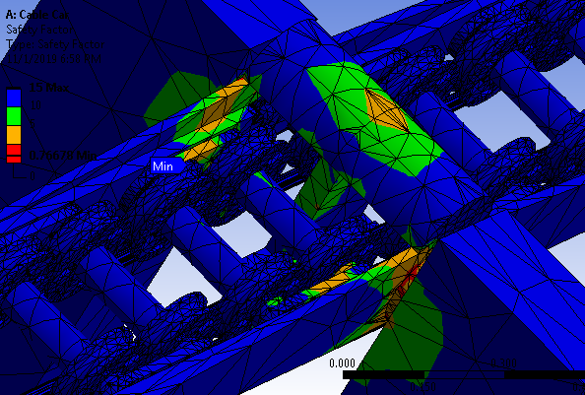
08
SAFETY FACTOR
analysis
conclusion
cad
about
limitations
SECOND MODEL

Slide 24
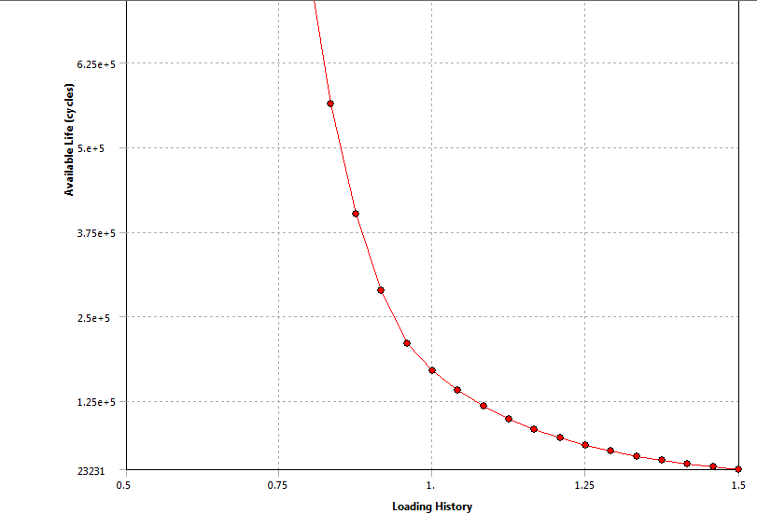
09
FATIQUE SENSTIVITY
analysis
conclusion
cad
about
limitations
SECOND MODEL

Slide 25
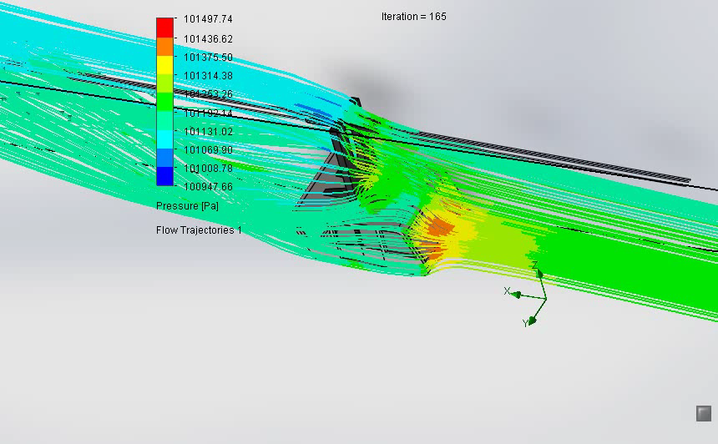
10
MOTION OF BODY
analysis
conclusion
cad
about
limitations
SECOND MODEL

Slide 26
PROPERTY | FIRST CAD MODEL | SECOND CAD MODEL
analysis
conclusion
cad
about
limitations
comparison

Slide 27
analysis
conclusion
limitations
cad
about
comparison

Slide 28
analysis
conclusion
cad
about
limitations
comparison

Slide 29

BHOOPATI
MANEESH
BIRENDAR
YADAV
DIVESH
KUMAR
BHAVANA
BHARATSINGH R
A PRESENTATION BY
GROUP 14

